Slide 1

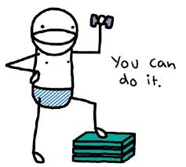

Gender Differences in the Effects of Subjective Feedback – a Computer Game-Based Experiment
Ewa Cukrowska-Torzewska, Andrea Kiss, Anna Lovász, Mariann Rigó, Ágnes Szabó-Morvai
November 15, 2016

Slide 2
Overview 1.
Does the effect of subjective feedback on performance differ by gender?
Types of supervisory (teacher, boss) feedback
  Performance feedback: info about performance
    „You scored 67 points.”
  Praise: info about performance + the environment’s valuation of it
    „67 points, good job!”
  Encouragement: info about environment’s expectation of future performance
    „You can do it.”
Model: individual’s choice of effort in a given task
  Expected benefit – expected cost
  Differential impact of feedback types by personality and gender
    Self confidence
Notes:
Feedback or communication?
Why do we need the model exactly?
Focus on gender directly, tie to personality in lit section?
Why not include performance feedback as a tested type? Why include score in all cases?

Slide 3
Overview 2.
Does the effect of subjective feedback on performance differ by gender?
Test: online computer game, randomized feedback
  Control: Objective feedback
  Treatment 1: Objective feedback + Praise
  Treatment 2: Objective feedback + Encouragement
  Analysis: effort and performance
  mean differences in outcomes by feedback type
  difference in these differences by gender
Gender differences in response to subjective feedback
Channel: differences in personality/self-confidence
Notes:
Feedback or communication?
Why do we need the model exactly?
Focus on gender directly, tie to personality in lit section?
Why not include performance feedback as a tested type? Why include score in all cases?

Slide 4
Implications
Does the effect of subjective feedback on performance differ by gender?
  Females could perform better in a different environment, a a more suitable „mix” of feedback
  Current/undifferentiated supervisory communication may lead to gender differences and quantifiable losses in performance (inefficiency)
  Also important for student/employee motivation by personality type
  Different effectiveness of feedback types along ability distribution
Notes:
Feedback or communication?
Why do we need the model exactly?
Focus on gender directly, tie to personality in lit section?
Why not include performance feedback as a tested type? Why include score in all cases?

Slide 5
Previous literature: Psychology & IO Psychology
Motivational impact of feedback, forms of praise, channels (Henderlong and Lepper, 2002)
  little about encouragement
Various theories:
  Self-determination theory (Deci and Ryan 1985, 2000)
  Cognitive evaluation theory (Deci et al 1975)
  Goal setting theory (Locke 1996, Bandura 1986)
    Basis of our model
  Core Self-Evaluations,CSE (Judge, Locke and Durham 1997)
    Focus on self confidence
Common conclusions:
  Individual differences can lead people to interpret the same feedback as encouraging, neutral, or discouraging
  Individual factors as well as environmental factors play an important role

Slide 6
Previous literature: Economics
The impact of objective performance feedback
  Bandiera et al 2012 - grade,
  Azmat and Iriberri 2010 – own grade and class grade,
  Hannan et al 2008 – relative performance feedback under various compensation schemes
Usually find a positive impact
  High ability, low self confidence females
Economic methodology:
  large-scale experiments
  heterogeneity (which groups are effected?)
  Focus on performance – economic implications
  but: less detailed in discussing underlying theories and channels

Slide 7
Contribution
Bring together theories and evidence on objective/subjective feedback from economics/psychology
Build an encompassing model: allows the simultaneous analysis of both objective and subjective feedback
    Praise, encouragement not studied in economic framework yet
    Encouragement rarely studied even in a psychology framework
    Types not previously tested in relation to each other
Online game method
  Large potential sample, easy utilization,
  High quality, detailed data
  Possibilities for future tests: combinations of feedback types, by task type, by frequency of feedback, by source of feedback, peer effects and competitiveness, differences in goal-setting, task clarity, etc…

Slide 8
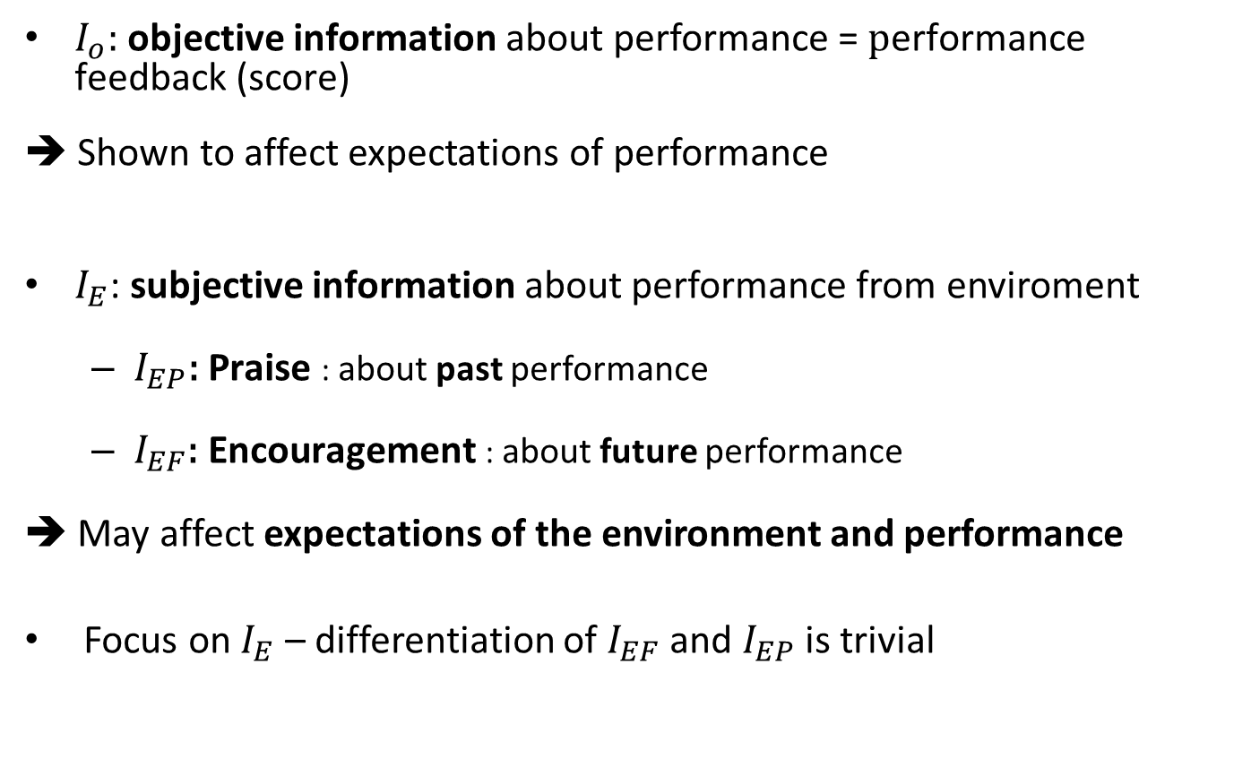
Model: Information content of feedback types
$I_{o}:$objective information about performance = $\text{p}\text{erformance} \text{feedback}\text{ (}\text{score}\text{)}$
➔ Shown to affect expectations of performance
$I_{E}$: subjective information about performance from enviroment
  $I_{EP}\text{: }\text{Praise}$: about past performance
  $I_{EF}\text{: }\text{Encouragement}$: about future performance
➔ May affect expectations of the environment and performance
Focus on $I_{E}$ – differentiation of $I_{EF}$ and $I_{EP}$ is trivial

Slide 9
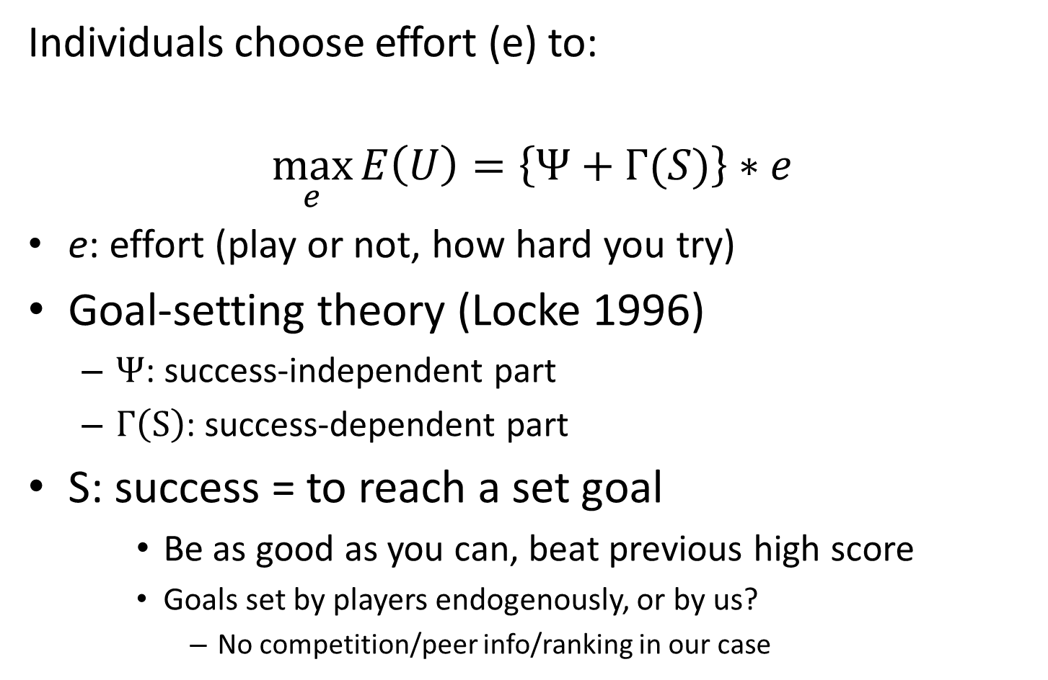
Utility maximization
Individuals choose effort (e) to:
$$\max_{e}{E\left(U\right)=\left\{Ψ+Γ(S)\right\}∗e}$$
  e: effort (play or not, how hard you try)
Goal-setting theory (Locke 1996)
  $Ψ$: success-independent part
  $Γ\left(S\right)$: success-dependent part
S: success = to reach a set goal
    Be as good as you can, beat previous high score
    Goals set by players endogenously, or by us?
      No competition/peer info/ranking in our case

Slide 10
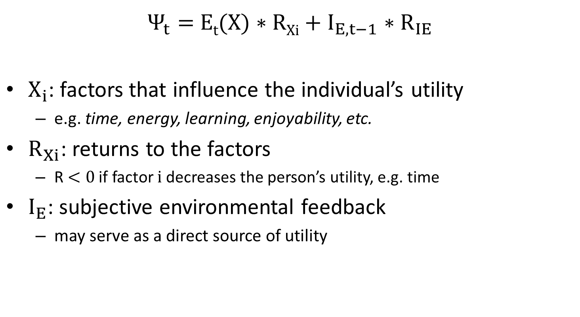

1. Success-independent part: $Ψ$
$$E\left(U\right)=\left\{Ψ+Γ(S)\right\}∗e$$
$Ψ_{t}=$ E_{t}(X) $∗RXi+I_{E,t−1}∗R_{IE}$
$X_{i}$: factors that influence the individual’s utility
  e.g. time, energy, learning, enjoyability, etc.
$R_{Xi}$: returns to the factors
  R $<0$ if factor $i$ decreases the person’s utility, e.g. time
$I_{E}$: subjective environmental feedback
  may serve as a direct source of utility

Slide 11
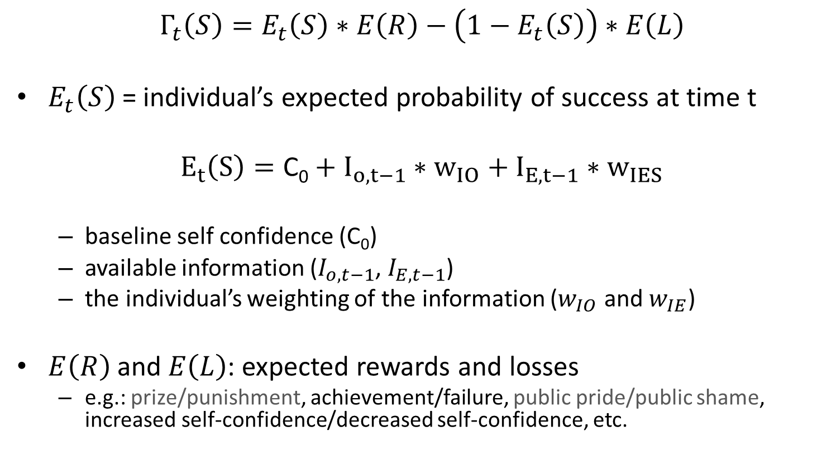

2. Success-dependent part: $Γ\left(S\right)$
$$E\left(U\right)=\left\{Ψ+Γ(S)\right\}∗e$$
$$Γ_{t}\left(S\right)=E_{t}\left(S\right)∗E\left(R\right)−\left(1−E_{t}\left(S\right)\right)∗E\left(L\right)$$
$E_{t}\left(S\right)$ = individual’s expected probability of success at time t
$$E_{t}\left(S\right)=\text{C}\text{0}+I_{o,t−1}∗w_{IO}+I_{E,t−1}∗w_{IES}$$
  baseline self confidence (C₀)
  available information ($I_{o,t−1}$, $I_{E,t−1}$)
  the individual’s weighting of the information ($w_{IO}$ and $w_{IE}$)
$E\left(R\right)$ and $E\left(L\right)$: expected rewards and losses
  e.g.: prize/punishment, achievement/failure, public pride/public shame, increased self-confidence/decreased self-confidence, etc.

Slide 12
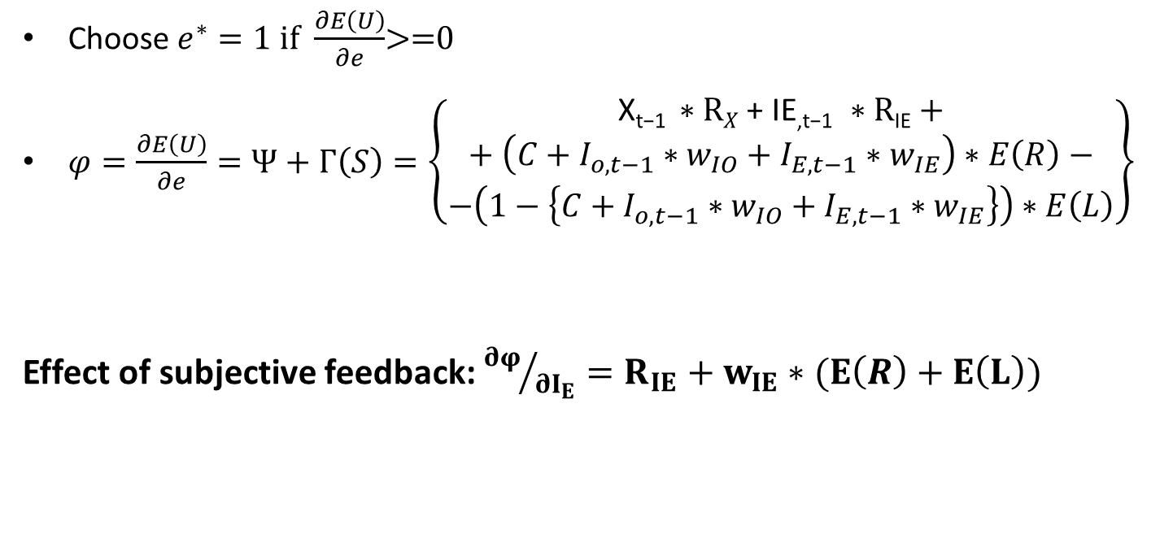
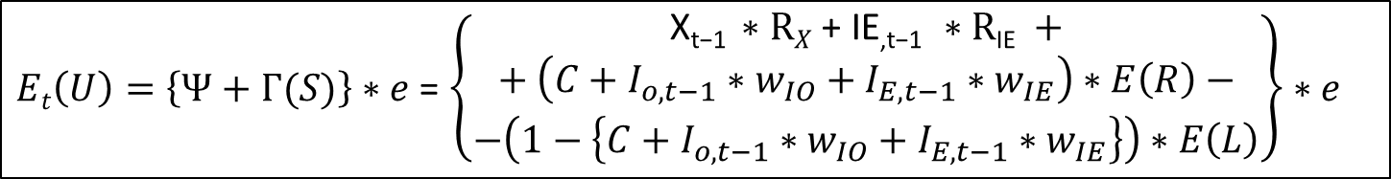
Optimal choice
$Et\left(U\right)=\left\{Ψ+Γ(S)\right\}∗e$ = $\left\{\begin{aligned}\begin{aligned}\text{X}\text{t}\text{−1 }∗RX \text{+ }\text{IE}\text{,}\text{t}\text{−1 }∗R\text{IE} + \\ + \left(C+I_{o,t−1}∗w_{IO}+I_{E,t−1}∗w_{IE}\right)∗E\left(R\right)−\end{aligned} \\ −\left(1−\left\{C+I_{o,t−1}∗w_{IO}+I_{E,t−1}∗w_{IE}\right\}\right)∗E\left(L\right)\end{aligned}\right\}∗e$
Choose $e^{∗}=1$ if $\frac{∂E\left(U\right)}{∂e}$>=0
$φ=\frac{∂E\left(U\right)}{∂e}=Ψ+Γ\left(S\right)=\left\{\begin{aligned}\begin{aligned}\text{X}\text{t}\text{−1 }∗RX \text{+ }\text{IE}\text{,}\text{t}\text{−1 }∗R\text{IE}+ \\ + \left(C+I_{o,t−1}∗w_{IO}+I_{E,t−1}∗w_{IE}\right)∗E\left(R\right)−\end{aligned} \\ −\left(1−\left\{C+I_{o,t−1}∗w_{IO}+I_{E,t−1}∗w_{IE}\right\}\right)∗E\left(L\right)\end{aligned}\right\}$
Effect of subjective feedback: ${∂φ}/{∂I_{E}}=R_{IE}+w_{IE}∗(E\left(R\right)+E\left(L\right))$

Slide 13
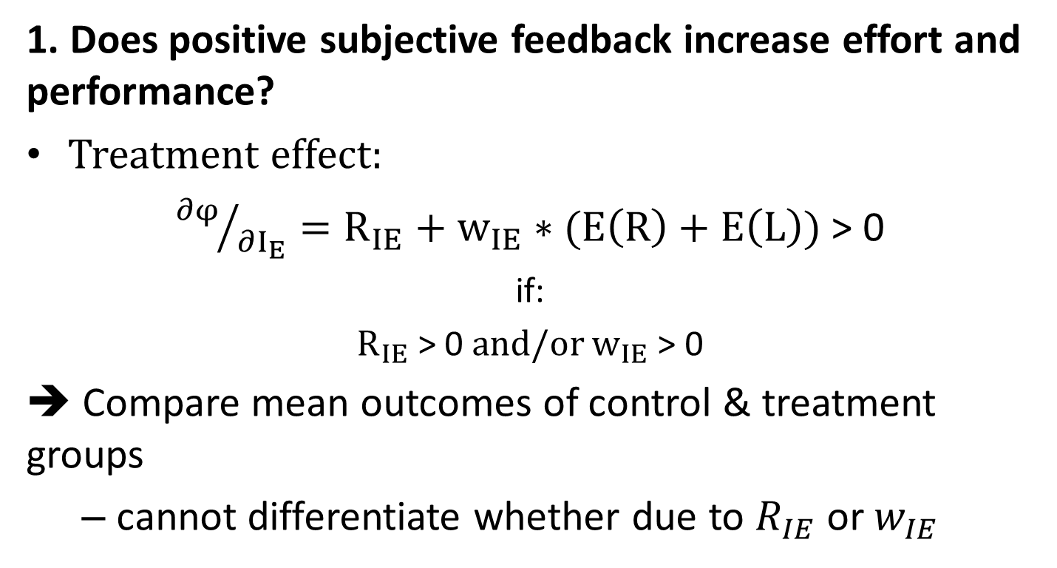
Tests
1. Does positive subjective feedback increase effort and performance?
Treatment effect:
${∂φ}/{∂I_{E}}=R_{IE}+w_{IE}∗(E\left(R\right)+E\left(L\right))$ > 0
if:
$R_{IE}$> 0 and/or $w_{IE}$> 0
➔ Compare mean outcomes of control & treatment groups
  cannot differentiate whether due to $R_{IE}$ or $w_{IE}$

Slide 14
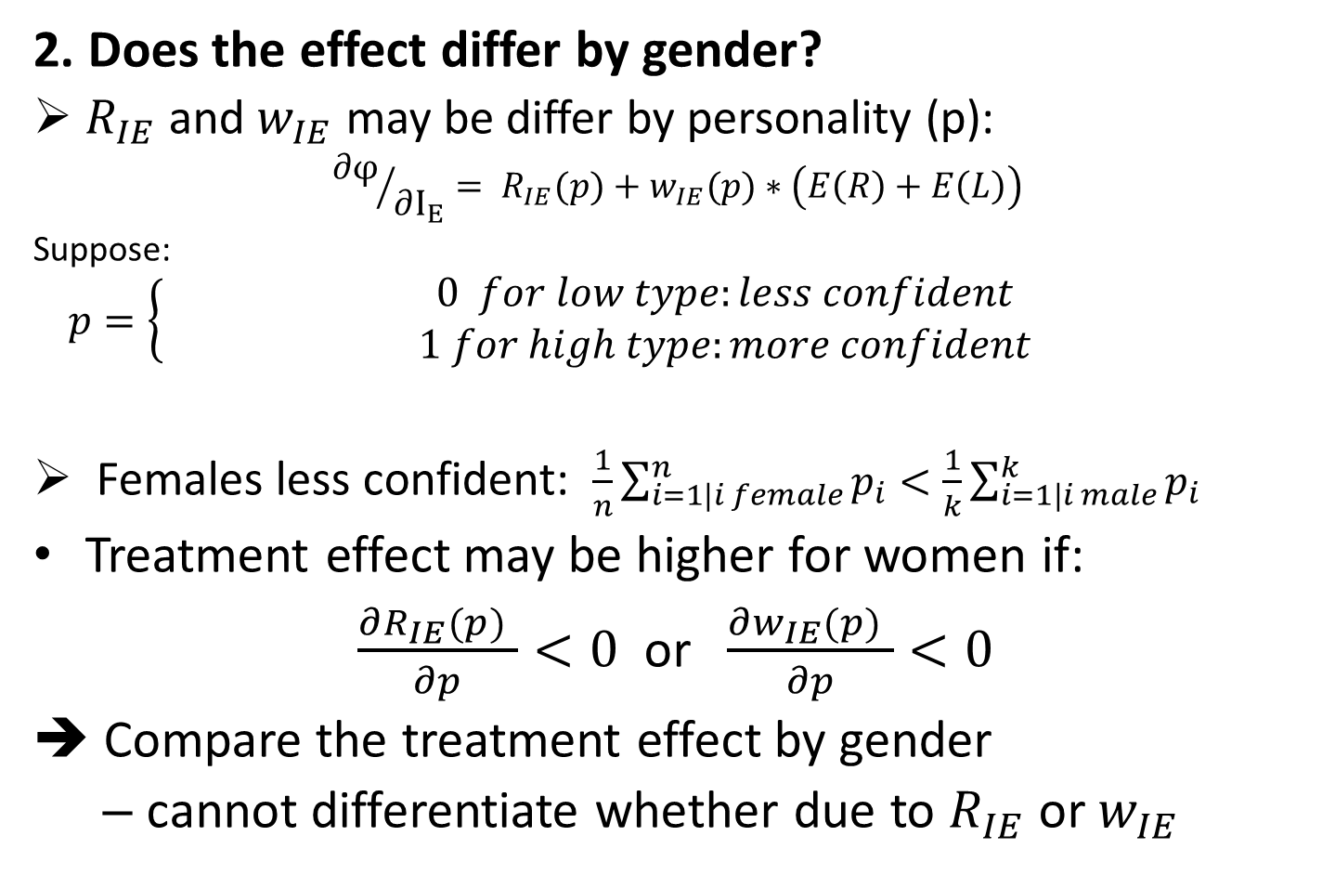
Tests
2. Does the effect differ by gender?
  $R_{IE}$ and $w_{IE}$ may be differ by personality (p):
  $${∂φ}/{∂I_{E}}= R_{IE}(p)+w_{IE}(p)∗\left(E\left(R\right)+E\left(L\right)\right)$$
  Suppose:
  $$p=\left\{\begin{aligned}0 for low type:less confident \\ 1 for high type:more confident \end{aligned}\right.$$
  Females less confident: $\frac{1}{n}\sum_{i=1|i female}^{n}{p_{i}}<\frac{1}{k}\sum_{i=1|i male}^{k}{p_{i}}$
Treatment effect may be higher for women if:
$\frac{∂R_{IE}(p) }{∂p}<0$ or $\frac{∂w_{IE}(p) }{∂p}<0$
➔ Compare the treatment effect by gender
  cannot differentiate whether due to $R_{IE}$ or $w_{IE}$

Slide 15
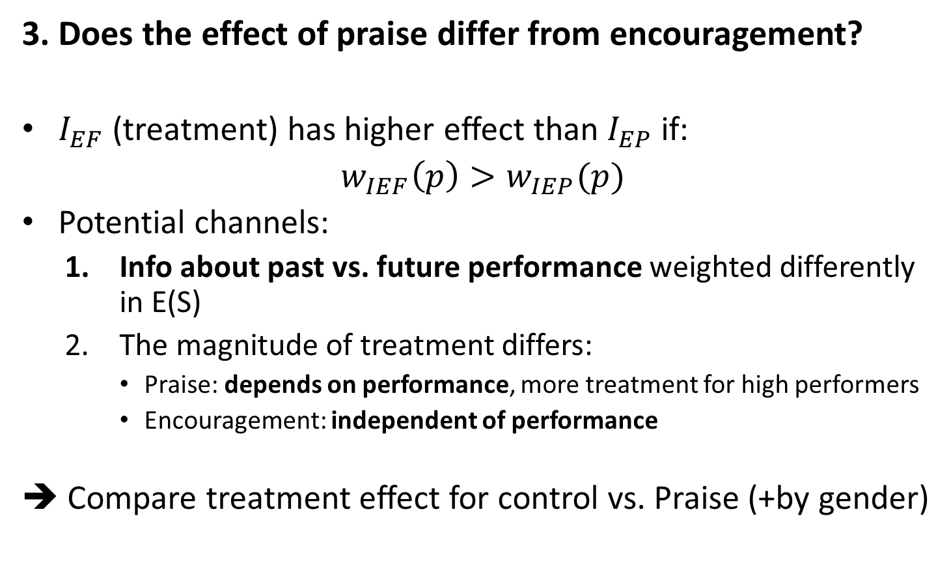
Tests
3. Does the effect of praise differ from encouragement?
$I_{EF}$ (treatment) has higher effect than $I_{EP}$ if:
$w_{IEF}\left(p\right)>w_{IEP}(p)$
Potential channels:
  Info about past vs. future performance weighted differently in E(S)
  The magnitude of treatment differs:
    Praise: depends on performance, more treatment for high performers
    Encouragement: independent of performance
➔ Compare treatment effect for control vs. Praise (+by gender)

Slide 16
Methodology
Computer game on a website:
  Data collection:
    selected classrooms in various countries
    online users
  simple game, requires concentration and effort
Randomized treatment:
  Control (Praise): Performance feedback (level)
  Control (Encour.): Performance feedback (score)
  Praise: Performance feedback (level) + Praise
  Encouragement: Performance feedback (score) + Encouragement
Players receive same feedback if play again within sessions
  but not between sessions
  Longer run effects
Can track individuals/sessions well: subsample analyses

Slide 17
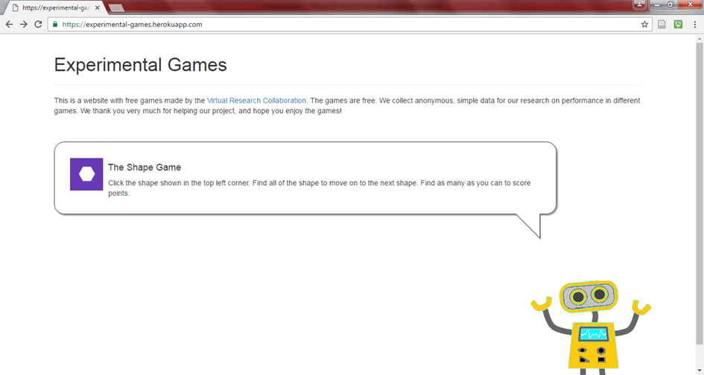
The Shape Game
https://experimental-games.herokuapp.com/#12112016

Slide 18
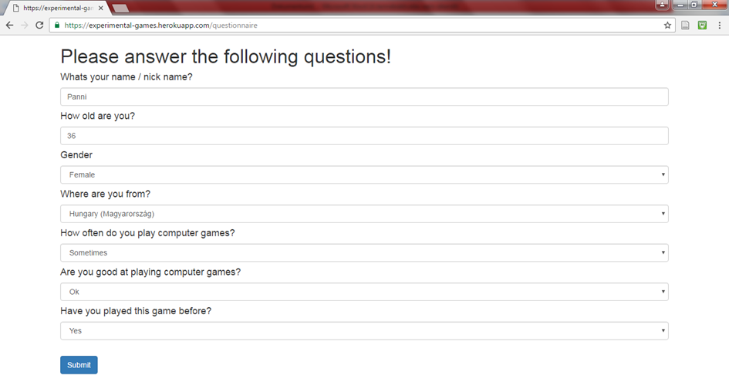

Slide 19
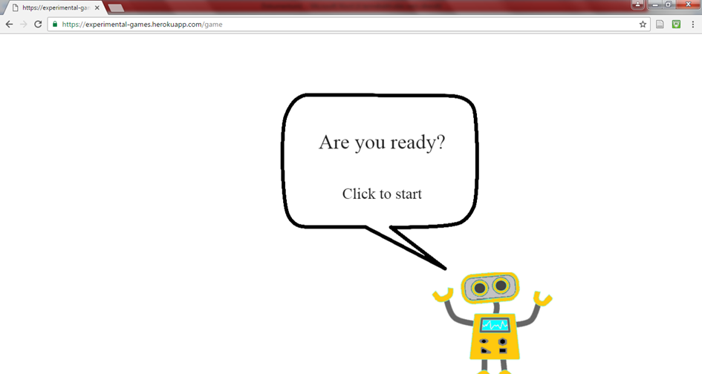

Slide 20
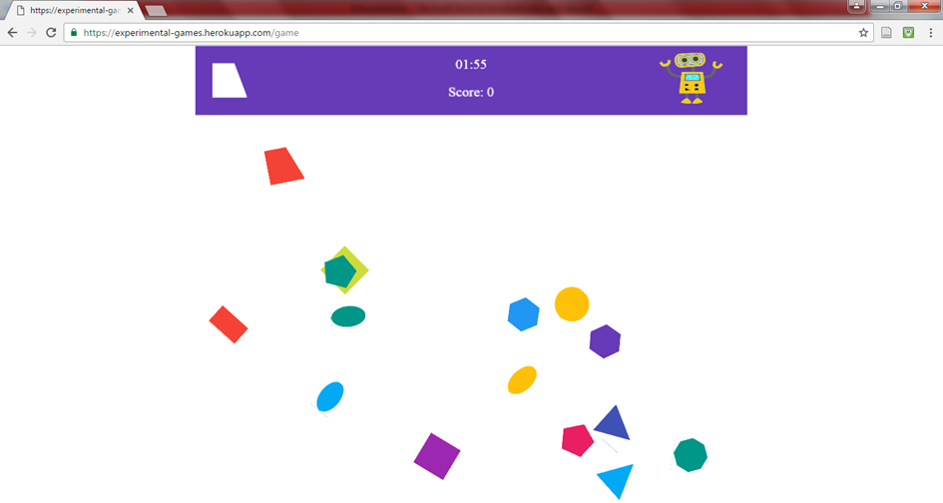

Slide 21
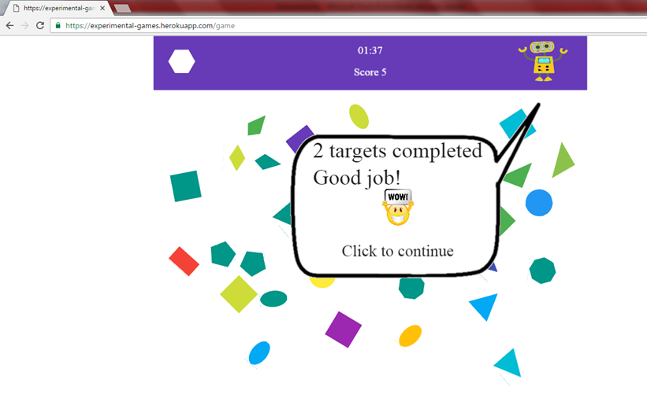

Slide 22
Feedback Specifications

Slide 23
Data
Rich data: every event (click/treatment), exact time (1000th second)
Outcome measures:
  Effort (number of clicks /whether plays again)
  Performance (score overall/over time)
Identifiers: track game/session/player
  Tracking token, IP address, url slug, nickname
Survey:
  Gender, age, location
  Whether player has played before
  Whether player plays games often
  How good player considers him/herself to be at playing games
  Automatic: touchscreen or not
Samples:
  first/subsequent games or sessions
  classroom vs. online user

Slide 24
Preliminary results: main stats
Test 1: treatment effect?
Effort: clicks
Treatment | mean | SD | N
control_enc | 52.1 | 19.7 | 37
control_pr | 53.4 | 11.3 | 31
encour | 50.3 | 17.3 | 39
praise | 49 | 19.6 | 21
Performance: end score
Treatment | mean | SD | N
control_enc | 40.3 | 17.2 | 37
control_pr | 43.2 | 11.3 | 31
encour | 38.9 | 16.3 | 39
praise | 36.9 | 18.3 | 21

Slide 25
Confidence and gender
 |  | Confidence
 |  | 0 | 1 | 2
Female | Mean score | 43.3 | 39.3
 | N | 29 | 27
Male | Mean score | 41.4 | 31.5 | 49.4
 | N | 24 | 31 | 17

Slide 26
Preliminary results: game-level means
Test 2: Gender difference in feedback effect?
Test 3: Difference by subjective feedback type?
 |  | control_enc | control_pr | encour | praise
Female | Mean score | 35.6 | 43.7 | 42.0 | 45.1
 | sd | 14.9 | 7.2 | 15.2 | 8.3
 | N | 15 | 13 | 17 | 11
 | T-test: diff>0 |  |  | 0.242 | 0.660
Male | Mean score | 43.4 | 42.8 | 36.5 | 27.7
 | sd | 18.2 | 13.7 | 17.0 | 22.1
 | N | 22 | 18 | 22 | 10
 | T-test: diff>0 |  |  | 0.204 | 0.033

Slide 27
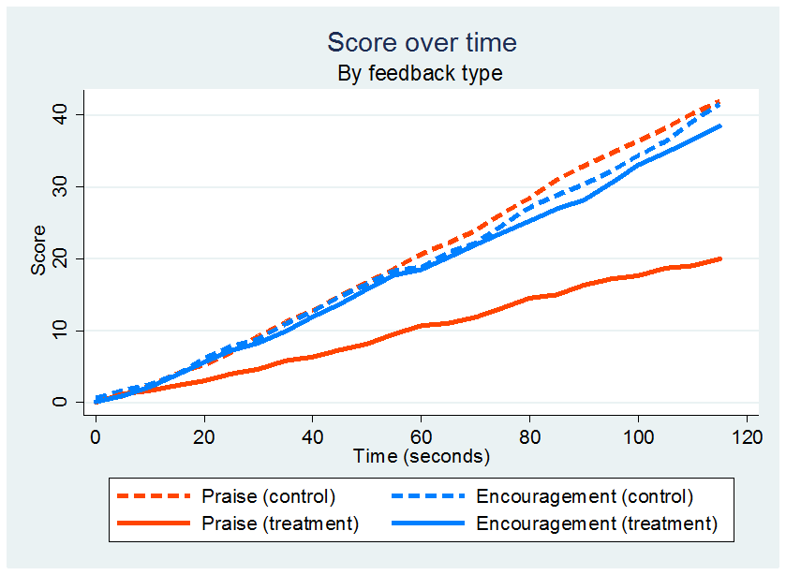
Preliminary results: performance over time

Slide 28
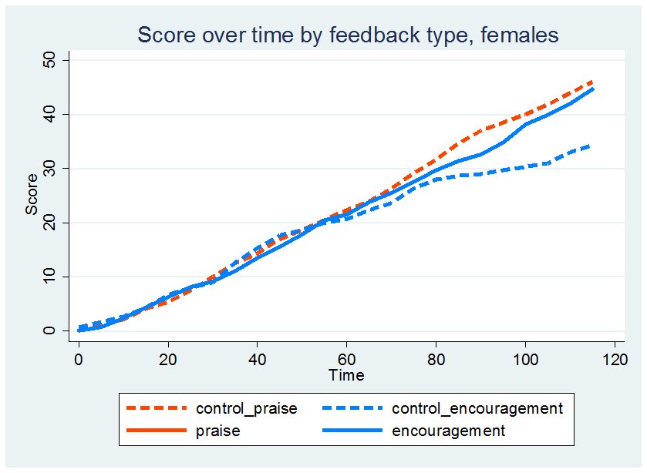
Preliminary results: performance over time

Slide 29
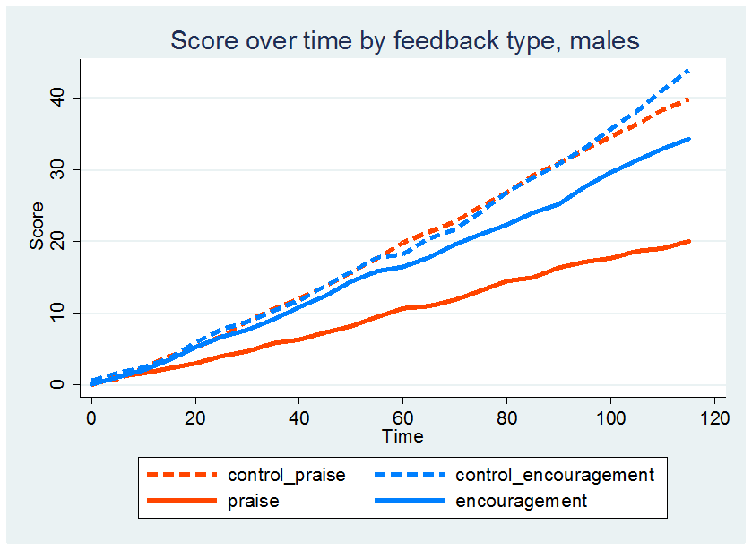
Preliminary results: performance over time

Slide 30
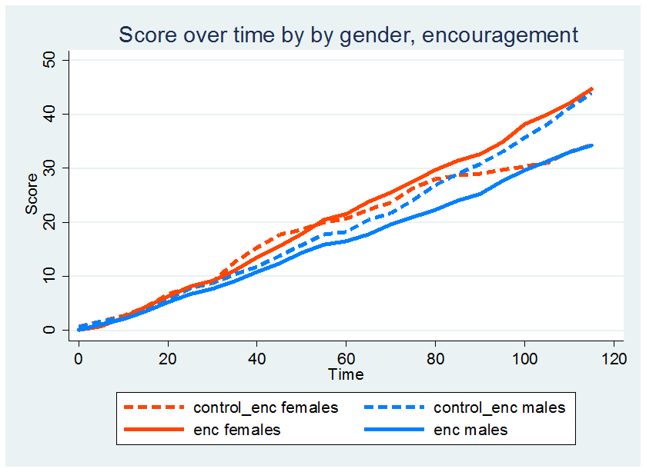
Preliminary results: performance over time

Slide 31
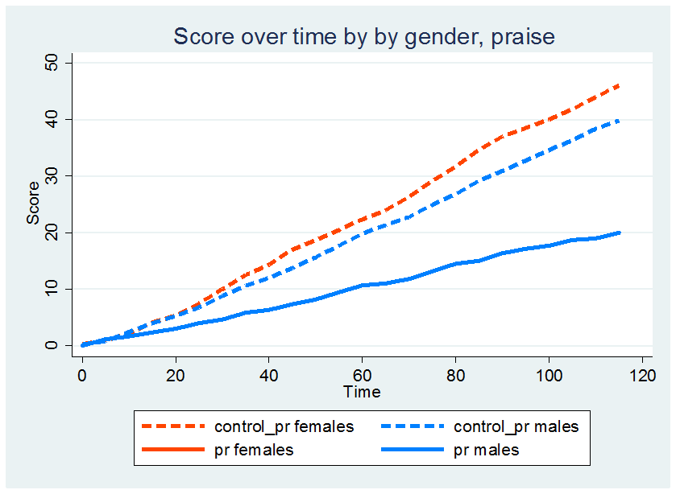
Preliminary results: performance over time

Slide 32
Conclusion and plans
Results so far: very few observations, but in the right direction
More detailed responses from testers also in line:
  Males/more confident annoyed by feedback
  Females/less confident like it
TO DO:
Include more personality questions?
Gather data!
  Careful with sample analysis
Results by gender & confidence
Consult psychologists for relevant literature
Consult educators/pedagogists for relevant literature

Slide 33


